Slide 1
Association Analysis

Slide 2
Definition
Mining association rules search for interesting relationship among items in given data set.
One of the Most common technique in data science
It is unsupervised learning systems.
Discover elements (items) that co-occur frequently within a data set.

Slide 3
Definition
Questions such as "if a customer purchases product A, how likely is he to purchase product B?" and
"What products will a customer buy if he buys C and D?" are answered by association-finding algorithms.
Association Rules is to find rules of the kind If X then (likely) Y
where X and Y can be single values, items
if (Car=Porsche and Gender=Male and Age<20) then (Risk=High and Insurance=High)).

Slide 4

Example
Typical example is market basket analysis.
This process analyses customer buying habits by finding association between different items that customer place in their “shopping Basket”.
In other words, finding out which items in the supermarket are purchase together, and which items never purchase together.
Customer1:
Milk, eggs, sugar, bread
Customer2:
Milk, eggs, cereal, bread
Customer3:
Milk, eggs

Slide 5
Applications
Telecommunication: each customer is a transaction containing the set of phone calls.
Credit Cards/ Banking Services each card/account is a transaction containing the set of customer’s payments
Medical Treatments each patient is represented as a transaction containing the ordered set of diseases
Basketball-Game Analysis each game is represented as a transaction containing the ordered set of ball passes

Slide 6
Transactions
An item: an article in a basket, or an attribute-value pair (e.g., Milk)
A transaction: items purchased in a basket; it may have TID (transaction ID)
A transactional dataset: A set of transactions

Slide 7
Transactions

Slide 8
Transactions
Itemset: A set of one or more items
{ milk, bread, eggs} (order unimportant)
Itemset I : a subset of possible items
e.g { milk, bread, eggs}
Or {milk,eggs}
k-itemset X = {x₁, …, x_{k}}

Slide 9
Transaction
ITEMS:
A = milk
B=bread
C=cereal
D=sugar
E= eggs

Slide 10
Transaction
Attributes converted to binary flags

Slide 11
Different data formats
The data can be in transaction form or table form
Transaction form: a, b
a, c, d, e
a, d, f
Table form: Attr1 Attr2 Attr3
a, b, d
b, c, e
Table data need to be converted to transaction form for association mining

Slide 12
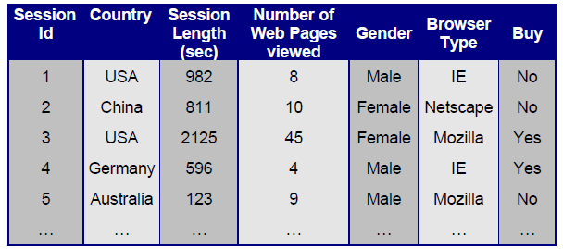
Different data formats
Example: Given the following dataset, how association rules handles the data.

Slide 13
Different data formats
Association rules only work with binary values in this case the table will work only with Buy and Gender :
Session ID | Gender | Buy
1 | Male | No
2 | Female | No
3 | Female | Yes
4 | Male | Yes
5 | Male | No

Slide 14
Different data formats
So, it will be applied to gender and Buy and generate rules such as:
Gender -> Buy
That means gender = male impales buy = yes
(note it take the first value as true and second as false)

Slide 15
Different data formats
If we want to use gender and buy as categorical, we need to convert nominal to binominal the table will be:
Gender=Female | Gender=Male | Buy=no | Buy=yes
False | True | True | False
True | False | True | False
Tue | False | False | True
False | True | False | True
False | True | True | False

Slide 16
Different data formats
The association rules will be such as:
[Gender = Male] --> [Buy = Yes]
[Buy = No] --> [Gender = Female]
[Buy = Yes] --> [Gender = Male]
[Gender = Female] --> [Buy = No]
[Gender = Female] --> [Buy = Yes]

Slide 17
Different data formats
If we include all nominal attributes:
……. | Buy = yes | …. | Browser = IE | … | Country = China | Country = USA
 |  |  |  |  | False | True
 |  |  |  |  | True | False
 |  |  |  |  | False | True
 |  |  |  |  | False | False
 |  |  |  |  | False | False
Association rules:
[Gender = Male] --> [Country = USA]
[Gender = Male] --> [Buy = Yes] (
[Gender = Male] --> [Browser Type = Mozilla]

Slide 18
Different data formats
If we include numerical vales e need to use Discretization to convert numbers to nominal
 | Len = range2 [790.333 - 1457.667] | Len = range1 [-∞ - 790.333]
 | True | False
 | True | False
 | False | True
 | False | True
 | True | False
Association rules:
[Len= range1 [-∞ - 17.667]] --> [Gender = Female]
Len = range1 [-∞ - 17.667]] --> [Country = USA]

Slide 19
Association Rules
An association rule is about relationships between two disjoint itemsets X and Y
X ⇒ Y
It presents the pattern when X occurs, Y also occurs.

Slide 20
Association Rules
Association rule R : Itemset1 => Itemset2
Itemset1, 2 are disjoint and Itemset2 is non-empty
meaning: if transaction includes Itemset1 then it also has Itemset2
Rule form: “Body => Ηead [support, confidence]”
Examples
A,B => E,C
A => B,C
major(x, “CS”) ^ takes(x, “DB”) => grade(x, “A”) [1%, 75%]

Slide 21
Association Rules
Association Rules find all sets of items (itemsets) that have support greater than the minimum support and then using the large itemsets to generate the desired rules that have confidence greater than the minimum confidence.
The lift of a rule is the ratio of the observed support to that expected if X and Y were independent.
Lift is a relative strength indicator showing the association between 2 Items.
Lift (Item 1, Item 2) = Confidence (Item 1, Item 2) / Support (Item 2)

Slide 22
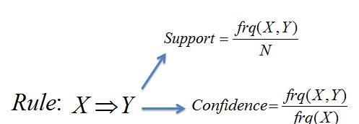
Support, confidence, lift

Slide 23
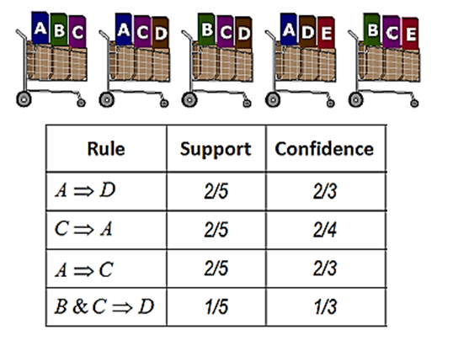
Example

Slide 24
Support and Confidence
Support ( A ⇒B)= 4/9=0.45
Support(A,B ⇒ C)=2/9= 0.22

Slide 25
Support and Confidence
Confidence( A ⇒B)= 4/6=0.67
Confidence(A,B ⇒ C)=2/4= 0.50

Slide 26
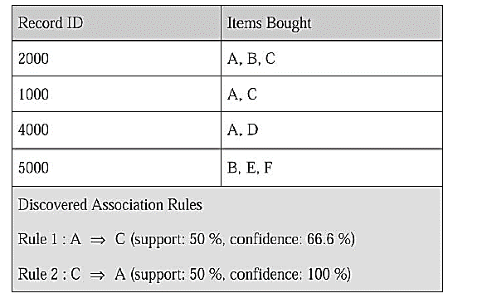
Support and Confidence

Slide 27
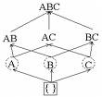
Frequent itemsets
The itemset frequency is the number of transactions that contain the particular itemset.
For example, frequency (AB)= 4.
Frequent itemset is an itemset that occurs at a certain minimum number of times, having itemset frequency ≥ Φ.
For example , suppose Φ=3 then itemsets that occurs more than three times are said to be frequent or Large itemset .

Slide 28
Frequent itemsets
Important concept:
“Every subset of a frequent set is frequent!”
Example:
Suppose {A,B} is frequent. ➔ {A} is frequent and {b} is frequent
Similar argument for larger itemsets

Slide 29
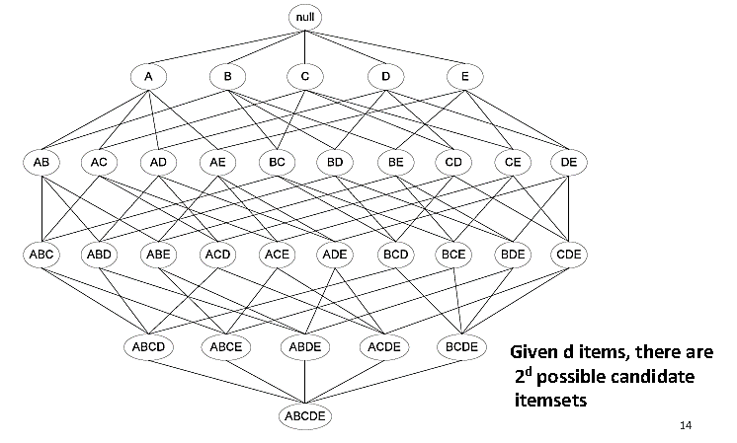
Frequent itemsets

Slide 30
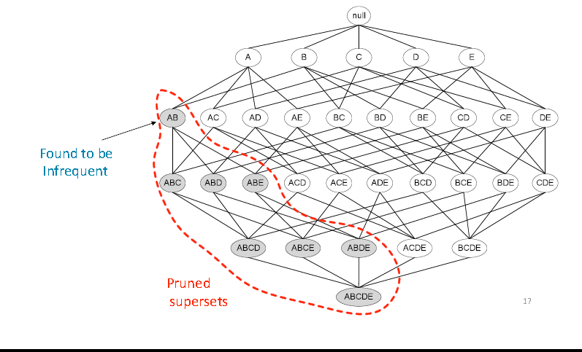
Frequent itemsets

Slide 31
Mining Association Rules
The mining of association rules from large database is a two-step process:
1) Find all frequent itemsets: That is, find all itemsets with frequency ≥ Φ.
2) From the frequent itemsets , generate association rules satisfying the minimum support and minimum confidence conditions.

Slide 32
Strong Rules
Strong rules are those that meet more than certain minimum support (minsup) and minimum confidence (minconf)
Example
An analyst interested in finding which supermarket item are purchased together may set a minsup to level of 20% and minconf level to 70%.
A fraud detection analyst would need to reduce the minimum support level to 1% or less, since few transactions are fraudulent.

Slide 33
Find all frequent itemsets
Step 1: Find all frequent itemsets Apriori algorithm
The algorithm Apriori computes the frequent itemsets in the database through several iterations.
Iterations i computes all frequent i-itemsets (itemsets with i elements). Each iteration has two steps: candidate (c) generation and candidate counting and selection (L)

Slide 34
APRIORI algorithm
Apriori’s Candidate Generation
For k=1, C1 = all 1-itemsets.
For k>1, generate Ck from Lk-1 as follows:
The join step
Ck = k-2 way join of Lk-1 with itself
If both {a1, …,ak-2, ak-1} & {a1, …, ak-2, ak} are in Lk-1,
then add {a1, …,ak-2, ak-1, ak} to Ck
(We keep items sorted).
The prune step
Remove {a1, …,ak-2, ak-1, ak} if it contains a non-frequent (k-1) subset

Slide 35
The Apriori Algorithm
Example
Database D
L₁
C₁
Scan D
C₂
C₂
L₂
Scan D
C₃
Scan D
L₃

Slide 36
The Apriori Algorithm
In the first iteration of the algorithm , each item is a member of the candidate 1-itemsets, C₁
Suppose that the minimum transaction support count required is 2 (i.e. minsup = 2/ 4 = 50%). The set of frequent 1-itemset L₁ can be determined . It consists of the 1 –itemsets satisfying the minimum support.
To discover the set of frequent 2-itemset, L₂, the algorithm uses L₁ * L₁ to generate a set of 2-itemsets C₂
Then D are scanned and support count of each candidate in C₂ is accumulated.
The set of frequent 2-itemsets , L₂, is then determined , consisting of those candidate 2-itemsets in C₂ having minimum support.

Slide 37
The Apriori Algorithm
C1
Another Example
support | itemset
6 | {I1}
7 | {I2}
6 | {I3}
2 | {I4}
2 | {I5}
D
items | TID
I1,I2,I5 | T100
I2,I4 | T200
I2,I3 | T300
I1,I2,I4 | T400
I1,I3 | T500
I2,I3 | T600
I1,I3 | T700
I1,I2,I3,I5 | T800
I1,I2,I3 | T900
L1
support | itemset
6 | {I1}
7 | {I2}
6 | {I3}
2 | {I4}
2 | {I5}

Slide 38
The Apriori Algorithm
C2
L2
support | itemset
4 | {I1,I2}
4 | {I1,I3}
1 | {I1,I4}
2 | {I1,I5}
4 | {I2,I3}
2 | {I2,I4}
2 | {I2,I5}
0 | {I3,I4}
1 | {I3,I5}
0 | {I4,I5}
support | itemset
4 | {I1,I2}
4 | {I1,I3}
2 | {I1,I5}
4 | {I2,I3}
2 | {I2,I4}
2 | {I2,I5}

Slide 39
The Apriori Algorithm
C3
L3
support | itemset
2 | {I1,I2,I3}
2 | {I1,I2,I5}
support | itemset
2 | {I1,I2,I3}
2 | {I1,I2,I5}

Slide 40
The Apriori Algorithm
Generation of 3-itemsets C2 from L2 using the Apriori property
Join step
C3=L2 * L2
C3={{I1,I2},{I1,I3},{I1,I5},{I2,I3},{I2,I4},I2,I5}} * {{I1,I2},{I1,I3},{I1,I5},{I2,I3},{I2,I4},I2,I5}}
C3= {{I1,I2,I3},{I1,I2,I5},{I1,I3,I5},{I2,I3,I4},{I2,I3,I5},{I2,I4,I5}}

Slide 41
The Apriori Algorithm
2- Prune using the apriori property
-The 2-item subset of {I1,I2,I3} are {I1,I2},{I1,I3},{I2,I3}. All 2-item subsets of {I1,I2,I3} are members of L2. Therefore keep {I1,I2,I3} in C3
-The 2-item subset of {I1,I2,I5} are {I1,I2},{I1,I5},{I2,I5}. All 2-item subsets of {I1,I2,I5} are members of L2. Therefore keep {I1,I2,I3} in C3
-The 2-item subset of {I1,I3,I5} are {I1,I3},{I1,I5},but {I3,I5} not member of L2. Therefore remove {I1,I2,I3} from C3
The 2-item subset of {I2,I3,I5} are {I2,I3},{I2,I5},but {I3,I5} not member of L2. Therefore remove {I2,I3,I5} from C3
The 2-item subset of {I2,I4,I5} are {I2,I4},{I2,I5},but {I4,I5} not member of L2. Therefore remove {I2,I4,I5} from C3
Therefore C3= {{I1,I2,I3,{I1,I2,I5}}

Slide 42
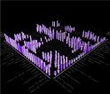
Generate Association Rules
Step 2: Derive rules from frequent itemsets
Frequent itemsets != association rules
One more step is required to find association rules
For each frequent itemset X,
For each proper nonempty subset A of X,
A ⇒B is an association rule if
Confidence (A ⇒ B) ≥ minConf,
where support (A ⇒ B) = support (AB) and
confidence (A ⇒ B) = support (AB) / support (A)

Slide 43
Generate Association Rules
Given frequent set {A,B,E}, what are possible association rules
A => B, E
A, B => E
A, E => B
B => A, E
B, E => A
E => A, B
__ => A,B,E (empty rule), or true => A,B,E

Slide 44
Generate Association Rules
Example
Given frequent set {A,B,E}, what association rules have minsup = 2 and minconf= 50% ?
A, B => E : conf=2/4 = 50%
A, E => B : conf=2/2 = 100%
B, E => A : conf=2/2 = 100%
E => A, B : conf=2/2 = 100%
Don’t qualify
A =>B, E : conf=2/6 =33%< 50%
B => A, E : conf=2/7 = 28% < 50%
__ => A,B,E : conf: 2/9 = 22% < 50%

Slide 45
Generate Association Rules
Another Example:
Suppose 234 is frequent, with supp=50%
Proper nonempty subsets: 23, 24, 34, 2, 3, 4, with supp=50%, 50%, 75%, 75%, 75%, 75% respectively
These generate these association rules:
23 => 4, confidence=100%
24 => 3, confidence=100%
34 => 2, confidence=67%
2 => 34, confidence=67%
3 => 24, confidence=67%
4 => 23, confidence=67%
All rules have support = 50%

Slide 46
Generate Association Rules
In order to obtain A ⇒B, we need to have Support(AB) and Support(A)
This step is not as time-consuming as frequent itemsets generation
It’s also easy to speedup using techniques such as parallel processing.

Slide 47
Measuring Interestingness
What are interesting association rules
Two popular measurements:
support; and
confidence
Large support & confidence thresholds ➔ only a small number of association rules, and they are likely known facts.
Small support & confidence thresholds ➔ too many association rules.

Slide 48
Measuring Interestingness
Subjective measures A rule (pattern) is interesting if
it is unexpected (surprising to the user); and/or
actionable (the user can do something with it)

Slide 49
Measuring Interestingness
Criticism to Support and Confidence
Among 5000 students
3000 play basketball
3750 eat cereal
2000 both play basketball and eat cereal
play basketball ⇒ eat cereal [40%, 66.7%] is misleading because the overall percentage of students eating cereal is 75% which is higher than 66.7%.
play basketball ⇒ not eat cereal [20%, 33.3%] is far more accurate, although with lower support and confidence

Slide 50
Measuring Interestingness
Association Rule LIFT
The lift of an association rule I => J is defined as:
lift = P(J|I) / P(J)
Lift (A => C) = confidence (A => C) / Support (C)
Note, P(I) = (support of I) / (no. of transactions)
ratio of confidence to expected confidence

Slide 51
Measuring Interestingness
lift(A => B) >1 means that A and B are positively correlated i.e. the occurrence of one implies the occurrence of the other.
lift(A => B) < 1 means that the occurrence of A is negatively correlated with ( or discourages) the occurrence of B.
lift(A => B) =1 means that A and B are independent and there is no correlation between them.

Slide 52
☺

